Slide 1
ELSEWeb meets SADI

Slide 2
Outline
Understanding ELSEWeb and the Model Web
Modeling the Chihuahuan Desert
Enabling Discovery through ontologies
Enabling Transformation through SADI
Making sense of it all through provenance

Slide 3
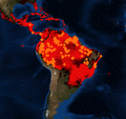
A Common Pattern of the Model Web
“…a system of interoperable computer models and databases communicating primarily via web services” – Geller 2009
Modeling Environment (WCS)
Web Client
Modeling Service (WPS)
Species Data

Slide 4
Potential Limitation of the Model Web
- Where can I find relevant data?
- How do I know it is relevant?
Discovery Limitations
- What transformations are required to satisfy requirements?
Web Client
Modeling Service (WPS)
Interface Requirement Disparities

Slide 5

Earth, Life, and Semantic Web
The goal of ELSEWeb is to streamline the flow of heterogeneous geographic, social, and geological data into Lifemapper modeling services
Data KB
Adapter KB
Web Client
Modeling Service (WPS)
Semantic Mediation Layer (SADI)

Slide 6
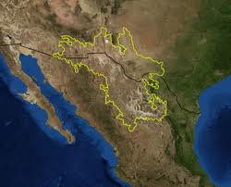
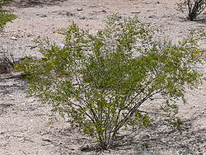
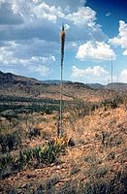
Chihuahuan Desert
Region: Northern Mexico, West Texas and Southern New Mexico
Terrain: Basins and Mountain Ranges
Climate: Mild Summer (35 – 40° C)
Flora:
Larrea Tridentata
Observation: Over the past 100 years, the Chihuahuan desert has encroached on existing grasslands, resulting in altered erosion patterns and thus an altered landscape.
Agave lechuguilla
Notes:
More informative title!!!! For example: the semantics of the scientific question

Slide 7
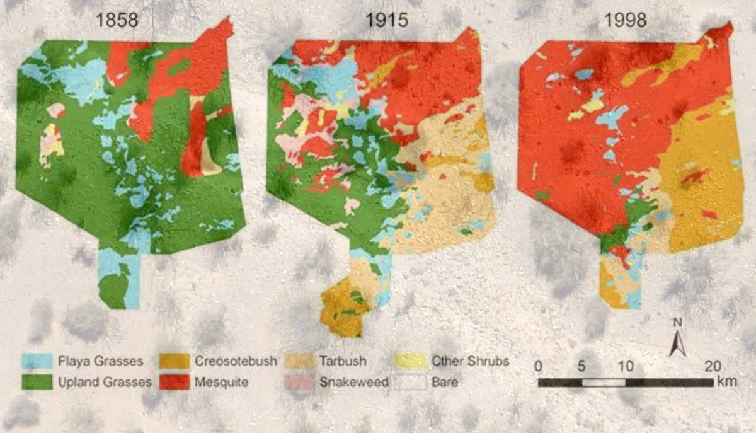
Transition from Grassland to Desert

Slide 8
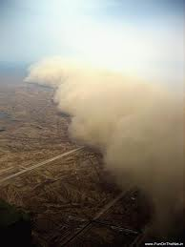
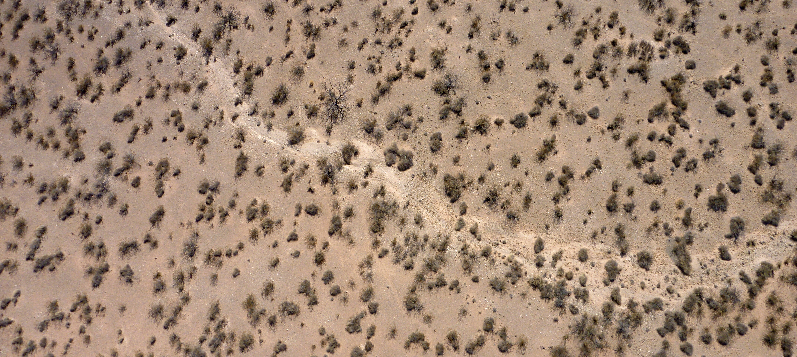
Implications of an Encroaching Desert Eco System
Sparse vegetation of the Chihuahuan desert
Dust storms containing allergens such as fungus
Sparse vegetation of mesquite shrubs leads to altered erosion patterns, creating an environment suitable for dust storms.
Notes:
Get high resolution pics from Fransca from viz wall. Get them from Frank ☺ Possible video, test to see if works. Be sure to give credit

Slide 9
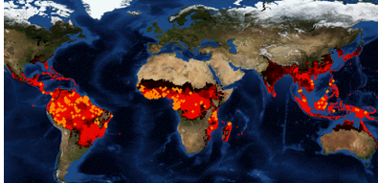

Species Distribution Modeling
Predictions: If we move to hotter climates with more variable precipitation, will we get further encroachment in the desert?
Will we get more erosion?
Will we get higher flood events?
Biodiversity Forecasting can provide insight:
“I want to model the transition from Chihuahua desert to biome X (probably steppe), during historic regions of drought”
Notes:
List all people at teams: lifemapper, edac, and UTEP. Include all people even non-authors. Introduce in the beginning with logos and picture of peoples.

Slide 10
Challenges: A Loaded Request
2
Denotes a duration of time encompassing a set of relevant environmental data
Data discovery, integration, transformation
1
These biomes are not defined solely by geographic coordinates; they are partially defined by its migrating flora (interpretation)
3
“I want to model the transition from grass lands to Chihuahuan desert (probably steppe), during historic periods of drought”
4
Drought denotes an event, that contextualizes a set of geospatial data within some space/time (interpretation)
Notes:
Identify the current and future work, perhaps by highlights. This is a work in progress, but we have some initial results for (1). This is achalleng that evolves but we are addressing the particular grant with was targeted with 1.

Slide 11
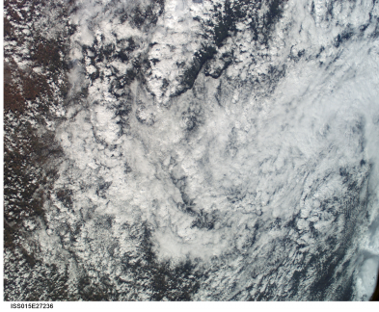
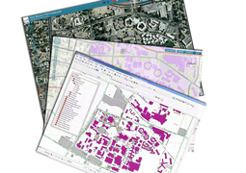
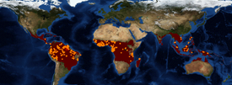
Questions of interest:
How to automate manual process?
How to keep track of data sources and analysis paths?
How to understand voluminous datasets used & generated?
Published
Web Services
Published
Web Services
NASA & others
Earth Data Analysis Center (EDAC)
Earth Science Data Provider
Lifemapper
Species Distribution Model Computational Experiments
Manual
Many
Datasets
IPCC & others
IPCC climate change & Others

Slide 12
Goal: ELSEWeb
The Earth, Life, and Semantic Web (ELSEWeb)
semantically-enabled service oriented environment
supporting Data-to-Model interactions
streamline the flow of heterogeneous geographic, social, and geological data into Lifemapper
Notes:
Show some semantic Web details: RDF, sparql, etc.

Slide 13
Questions of interest:
How to automate manual process? Semantic technologies
How to keep track of data sources and analysis paths?
How to understand voluminous datasets generated?
Reuse
CardioShARE
Knowledge Base
WORKING DEMO
Published 1
Web Service
Semantic Service Orchestration
Semantic Automated Discovery & Integration
(SADI) Services
Semantic annotation of Service inputs and outputs
Service “wrappers”
Published
Web Services
Published
Web Services
Earth Data Analysis Center (EDAC)
Lifemapper
Species Distribution Models

Slide 14
Questions of interest:
How to automate manual process? Semantic technologies
How to keep track of data sources and analysis paths? Provenance
How to understand voluminous datasets generated?
MOCKED UP DEMO
Reuse
CardioShARE
Knowledge Base
Overall provenance using
PROV Standard
+ Extensions in PML3
WebProbe
Provenance
Published 1
Web Service
Provenance
Provenance
Provenance
Published
Web Services
Published
Web Services
Earth Data Analysis Center (EDAC)
Lifemapper
Species Distribution Models

Slide 15
Existing Model Web Initiatives
E-Habitat
ELSEWeb differs by introducing a semantic layer between OGC compliant data and the models that ingest the data.
The goal is to introduce a more flexible environment where users can map their metadata descriptions to the ELSEWeb data model.

Slide 16
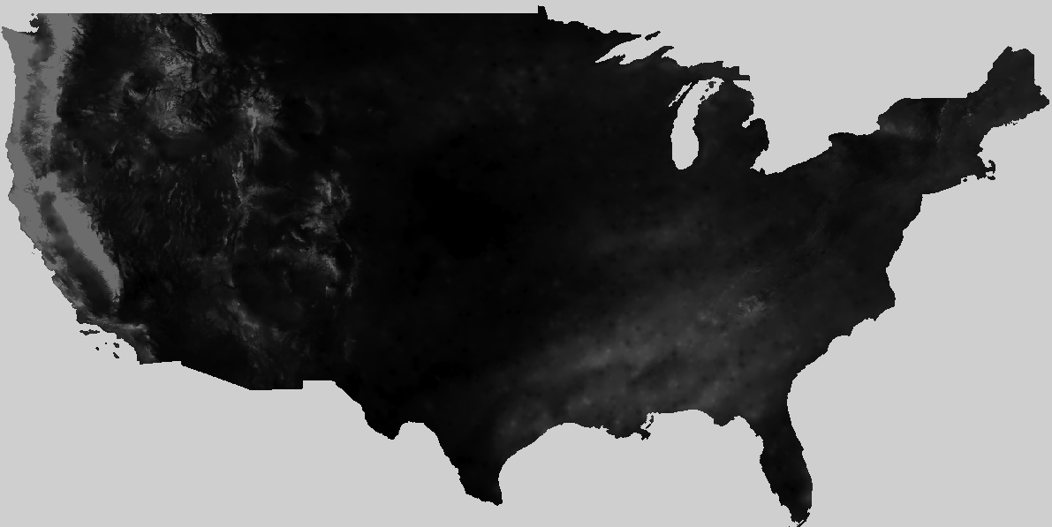
Earth Data Analysis Center
CF Keywords
GCMD
Categories
WCS Get Capabilities
XML
FGDC XML
ISO
19115
Topic
Categories
Metadata Store
Data Store

Slide 17
Desirable Data Properties
What kind of data?
OBOE: Observation Ontology
Where can I get the data?
DCAT: Data Catalog Vocabulary
How was the data generated?
Who was responsible for publishing?
When was it generated?
PROV-O: Provenance Ontology

Slide 18
EDAC Semantic Data Model
dcat:dataset
dcat:distribution
Catalog
Dataset
Distribution
rdfs:subClassOf
dc:temporal
dc:spatial
PeriodOfTime
WCSCoverage
Location
oboe:ofCharacteristic
oboe:measurementFor
Characteristic
Measurement
Observation
DCAT
rdfs:subClassOf
oboe:ofEntity
OBOE
Activity
Entity
PROVO

Slide 19
Frank’s Loin Description
Individual: EDAC-Environmental-Datasets
Types:
elsewebdata:WCSCoverageSet
Facts:
dcat:dataset <http://ontology.cybershare.utep.edu/ELSEWeb/data/coverages.owl#349396_dataset>,
dcat:dataset <http://ontology.cybershare.utep.edu/ELSEWeb/data/coverages.owl#349399_dataset>,
dcat:dataset <http://ontology.cybershare.utep.edu/ELSEWeb/data/coverages.owl#349397_dataset>,
dcat:dataset <http://ontology.cybershare.utep.edu/ELSEWeb/data/coverages.owl#349395_dataset>,
dcat:dataset <http://ontology.cybershare.utep.edu/ELSEWeb/data/coverages.owl#349398_dataset>
Individual: <http://ontology.cybershare.utep.edu/ELSEWeb/data/coverages.owl#349399_dataset>
Types:
elsewebdata:WCSCoverageDataset
Facts:
prov:wasGeneratedBy <http://ontology.cybershare.utep.edu/ELSEWeb/data/coverages.owl#349399_measurement>,
terms:temporal duration_0,
terms:spatial region_0,
dcat:distribution <http://ontology.cybershare.utep.edu/ELSEWeb/data/coverages.owl#349399_distribution>,
elsewebdata:hasID 349399

Slide 20
Service 1: Extracts WCS TIFF Data from WCS Multipart MIME message
WCSCoverage
1
hasWCSCoverage1
WCSCoverage
Sequence
…
…
WCSCoverage
10
hasWCSCoverage10
WCSPayload
Extractor
hasWCSPayload1
xsd:anyURI
WCSPayload
Sequence
…
…
hasWCSPayload10
xsd:anyURI
SADI
Service
Data Type
OWL
Class

Slide 21
Service 2: Invokes Lifemapper Modeling Rest Service
hasWCSPayload1
xsd:anyURI
Experiment
Stage3
hasWCSCoverageSet
WCSPayload
Sequence
…
…
hasWCSPayload10
xsd:anyURI
hasAlgorithm
xsd:string
Lifemapper
hasOccurrenceSetID
xsd:string
Experiment
Stage4
xsd:string
hasLifemapperModelURL
SADI
Service
Data Type
OWL
Class

Slide 22
An Example SADI Service: Extractor
Catalog
Dataset
rdfs:subClassOf
rdfs:subClassOf
WCSCoverage
Sequence
elseweb:dataset 1
TargetWCS
Coverage
elseweb:dataset n
rdfs:subClassOf
myGrid:inputParameter
rdfs:subClassOf
SADI
WCSPayloadExtractor
Experiment
ELSEWeb
myGrid:outputParameter
ScenarioLayer
Sequence
elseweb:payload 1
WCSPayload
elseweb:payload n

